Slide 1
AI-Based System for Early Disease Prediction

Slide 2
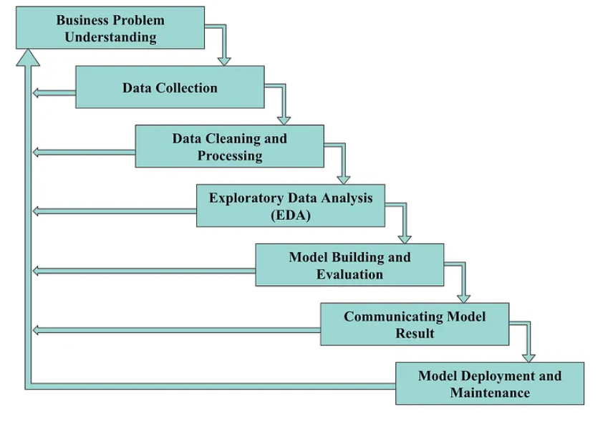

Slide 3
AI-Based System for Early Disease Prediction
AI-based systems for early disease prediction involve the use of advanced algorithms and data-driven approaches to identify potential health conditions at an early stage. These systems leverage machine learning (ML), deep learning (DL), and other AI technologies to analyze large datasets, uncover patterns, and provide predictions or recommendations for preventive healthcare.

Slide 4
Key Components of an AI-Based Disease Prediction System
Data Collection and Integration:
Data from multiple sources such as Electronic Health Records (EHR), medical imaging, wearable devices, and genetic profiles.
Includes structured (e.g., lab results) and unstructured data (e.g., doctors’ notes).
Pre-processing:
Data cleaning and handling missing values.
Feature extraction and transformation to prepare data for analysis.
Feature Selection:
Identifying relevant features such as biomarkers, symptoms, or environmental factors to improve model accuracy.
Techniques: Rough Set Theory, Entropy-based methods, or statistical tests.
Machine Learning Models:
Algorithms like Decision Trees, Random Forests, Support Vector Machines (SVM), and Gradient Boosting for early disease detection.
Example: Logistic Regression for binary classification (e.g., disease vs. no disease).
Deep Learning Models:
Use of Convolutional Neural Networks (CNNs) for medical imaging and diagnosis.
Recurrent Neural Networks (RNNs) and Long Short-Term Memory (LSTM) networks for time-series data like heart rate or glucose monitoring.
Integration with IoT Devices:
Wearable devices (e.g., fitness trackers, glucose monitors) for real-time data.
IoT-enabled smart systems for continuous health monitoring.

Slide 5
Techniques and Approaches
Predictive Analytics:
Use statistical models and ML algorithms to predict the likelihood of diseases based on historical and real-time data.
Natural Language Processing (NLP):
Analyze unstructured data such as clinical notes, patient reviews, or radiology reports.
Ensemble Learning:
Combines predictions from multiple models to enhance reliability and accuracy.
Personalized Medicine:
AI systems analyze individual health profiles to recommend personalized prevention or treatment plans.
Explainable AI (XAI):
Ensures interpretability of the model predictions to gain trust and meet medical regulatory standards.

Slide 6
Applications of Early Disease Prediction
Chronic Diseases:
Diabetes: Predict onset using glucose levels, diet, and lifestyle patterns.
Cardiovascular diseases: Analyze ECG data, cholesterol levels, and lifestyle factors.
Cancer Detection:
AI models identify patterns in imaging (e.g., mammograms, MRIs) and genomic data for early-stage diagnosis.
Neurological Disorders:
Predict conditions like Alzheimer's or Parkinson's through speech, movement analysis, or imaging.
Infectious Diseases:
Early detection of epidemics using epidemiological data and symptom patterns.

Slide 7
Advantages of AI in Early Disease Prediction
Early Diagnosis and Prevention:
Allows timely medical intervention, reducing disease progression and complications.
High Accuracy:
Outperforms traditional methods by analyzing complex data relationships.
Cost-Effective:
Reduces the cost of late-stage treatments and hospitalizations.
Scalability:
Capable of processing vast amounts of data from diverse populations.

Slide 8
Challenges and Ethical Considerations
Data Privacy and Security:
Ensuring compliance with regulations like GDPR and HIPAA for patient data.
Bias in Models:
Addressing biases due to unbalanced datasets or improper feature selection.
Regulatory Approvals:
Obtaining certifications from health authorities for AI-based diagnostic systems.
Interpretability:
Making complex AI models understandable for clinicians and patients.

Slide 9
Future Trends
Integration with Genomics:
AI systems analyzing genetic data for personalized predictions.
Federated Learning:
Enhancing privacy by training models on distributed datasets without centralizing patient information.
Real-time Monitoring:
IoT-enabled AI systems for continuous monitoring and alerts.
Hybrid Models:
Combining ML and DL approaches for robust predictions.

